Slide 1






Problem Statement
ERP System
Graduation project Cycle 3
Team 6

Slide 2

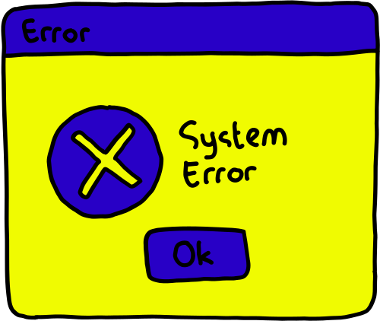

Problem Statement
Problem Statement & ERP Vision
Problem Statement
Disconnected systems
Manual processes
Data inconsistency
Slow decision-making

Slide 3

Problem Statement
Problem Statement & ERP Vision
Why ERP?
One centralized system
Shared database
Real-time data
Process automation

Slide 4


Problem Statement
Problem Statement & ERP Vision
Our ERP Vision
Integrated business modules
Intelligent analytics
Secure cloud infrastructure
Scalable architecture

Slide 5



Problem statement
HR
HR Module & Objective
HR Module
Objective
Digitize HR processes to improve efficiency, reduce manual work, and enhance employee experience through a unified ERP system.

Slide 6
Problem statement
HR
Employee Lifecycle Management
Employee Lifecycle Management
The HR module covers the full employee lifecycle from hiring to offboarding, ensuring all HR operations are centralized and automated.
Recruitment & Hiring
Attendance & Leave Management
Performance Evaluation
Offboarding
Training & Development
Onboarding
Payroll

Slide 7

Problem statement
HR
Digital HR Workflows
Digital HR Workflows
(ERP Ready)
HR policies were transformed into automated, ERP-ready workflows to ensure consistency, accuracy, and faster decision-making.
Online leave requests & approvals
Automated payroll rules
Structured performance review processes
Reduced manual follow-ups

Slide 8


Problem statement
HR
HR Outcome
HR Module Outcome
A fully digital HR framework that improves operational efficiency, supports data-driven decisions, and enhances overall employee experience.

Slide 9

Problem Statement
HR
Finance
Insert your topic here
The Overview
Designed Finance module within an ERP system for Konecta and Focused on end-to-end financial cycle automation, we Covered: Invoicing, Expenses, Budgeting, Payroll and Ensured integration, approval workflows, and accounting posting and Ensured integration with HR, Accounting, and Budget control and Aimed to enhance financial control, transparency, and decision-making.

Slide 10
Problem Statement
HR
Finance
Insert your topic here
Core Financial Processes
Invoicing: approval → client → payment → accounting
Expenses: employee → manager → budget → finance
Payroll: HR data → salary calculation → approval → payment
All processes follow validation and approval workflows

Slide 11
Problem Statement
HR
Finance
Insert your topic here
Finance Module – Key Achievements
Invoicing Module:
Create and manage client invoices
Approval workflow before sending to client
Automatic PDF generation and email dispatch
Payment tracking (Sent, Overdue, Paid)
Automatic posting to General Ledger
Expense Tracking Module:
Employees submit expenses with receipts
Manager approval workflow
Automatic budget consumption update
Finance notified for reimbursement
Full audit trail for all expenses

Slide 12
Problem Statement
HR
Finance
Insert your topic here
Finance Module – Key Achievements
Budgeting Module:
Create annual or quarterly budgets
Define budget lines per department or cost center
Real-time tracking: Planned vs Actual spend
Automated alerts when consumption exceeds thresholds
Budget expiration and performance reporting
Payroll Module:
Integrated with HR attendance and contracts
Automated payroll batch creation
Gross, deductions, and net salary calculation
Finance approval before payment
Automatic GL posting and bank payment file

Slide 13
Problem Statement
HR
Finance
Insert your topic here
Conclusion & Business Impact
Designed ERP finance workflows, not just accounting entries.
Simulated real corporate financial processes
Hands-on exposure to enterprise ERP design.
this project was not about building financial features, but about designing how finance actually operates inside a real company.

Slide 14
Problem Statement
HR
Finance
Full Stack
Full Stack ERP System
Introduction
A Full Stack ERP (ERB) System is a complete digital system that manages an organization’s activities such as HR, payroll, finance, and operations using integrated software technologies.
It combines front-end, back-end, database, and integration layers into one unified platform.
Explanation:
Instead of using separate systems for each department, ERP connects everything into one system, improving efficiency and accuracy.

Slide 15
Problem Statement
HR
Finance
Full Stack
Full Stack ERP System
Front-End Layer
What it is:
The front-end is the user interface of the ERP system.
Examples:
Employee portals
HR dashboards
Admin panels
Explanation:
This is where employees and managers log in, apply for leave, view payroll, and access reports.
A good front-end makes the system easy to use and user-friendly.

Slide 16
Problem Statement
HR
Finance
Full Stack
Full Stack ERP System
Back-End Layer
What it is:
The back-end handles business logic and processing.
Examples:
Payroll calculation
Leave approval rules
Performance evaluation processing
Explanation:
When a user performs an action on the front-end, the back-end processes the request and applies company rules before saving the data.

Slide 17
Problem Statement
HR
Finance
Full Stack
Full Stack ERP System
Database Layer
What it is:
The database stores all ERP data securely.
Data Stored Includes:
Employee records
Attendance data
Salary details
Training history
Explanation:
All information is stored in one centralized database, ensuring data consistency, accuracy, and easy access.

Slide 18
Problem Statement
HR
Finance
Full Stack
Full Stack ERP System
Integration Layer
What it is:
This layer connects different ERP modules and external systems.
Examples:
HR module connected to payroll
ERP connected to finance system
Attendance machines connected to ERP
Explanation:
Integration allows automatic data sharing, avoiding duplicate entries and reducing errors.

Slide 19
Problem Statement
HR
Finance
Full Stack
Full Stack ERP System
Security Layer
What it is:
Security controls access and protects data.
Features:
Role-based access
Login authentication
Data encryption
Explanation:
Only authorized users can access specific data, ensuring confidentiality and compliance.

Slide 20
Problem Statement
HR
Finance
Full Stack
Full Stack ERP System
Conclusion
A Full Stack ERP (ERB) System provides a complete digital solution by integrating technology, people, and processes.
It helps organizations achieve efficiency, transparency, and digital transformation.

Slide 21
Problem Statement
HR
Finance
Full Stack
Cloud Computing
Insert your topic here
Core Infrastructure
VPC Design: Custom VPC with 4 subnets (2 public, 2 private) across multiple AZs.
EC2 Configuration: t3.large instance running Ubuntu 22.04 LTS.
Performance Optimization: Unlimited CPU credits enabled via Terraform.
Storage: 50 GiB gp3 EBS volume attached.
Visuals: VPC Resource Map + EC2 Instance Summary screenshots.

Slide 22
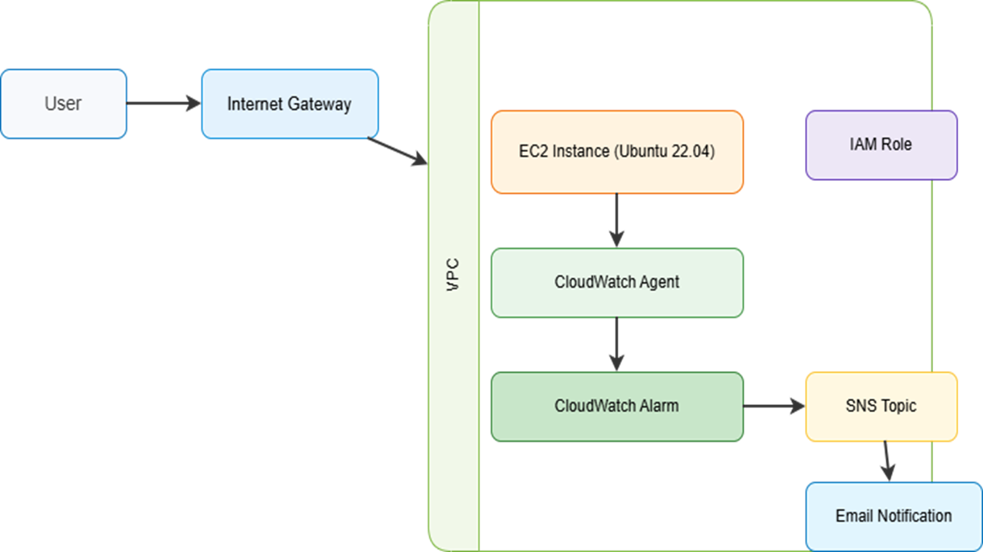
Problem Statement
HR
Finance
Full Stack
Cloud Computing
Insert your topic here
Architecture Diagram

Slide 23
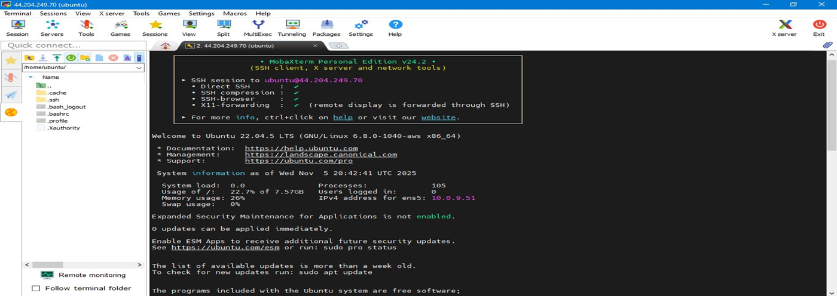
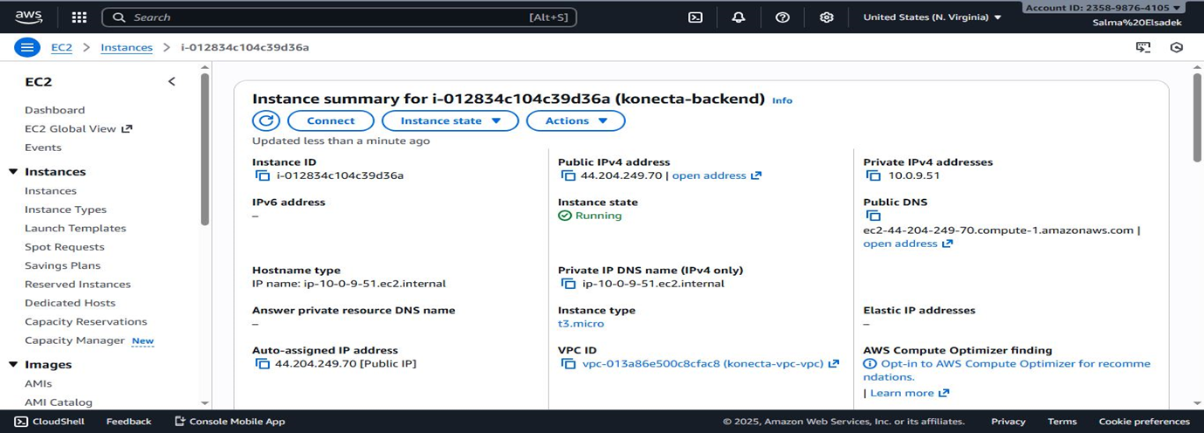
Problem Statement
HR
Finance
Full Stack
Cloud Computing
Insert your topic here
EC2 & VPC

Slide 24
Problem Statement
HR
Finance
Full Stack
Cloud Computing
Insert your topic here
Monitoring & Alert
CloudWatch Alarms: CPU utilization alarm triggered above 70%.
Cost Management: Low CPU Credit Balance alarm configured.
Incident Notification: SNS email alerts on alarm state changes.
Real-time Visibility: CloudWatch dashboard for live monitoring.
Visuals: CloudWatch Alarms list + Monitoring Dashboard graph.

Slide 25
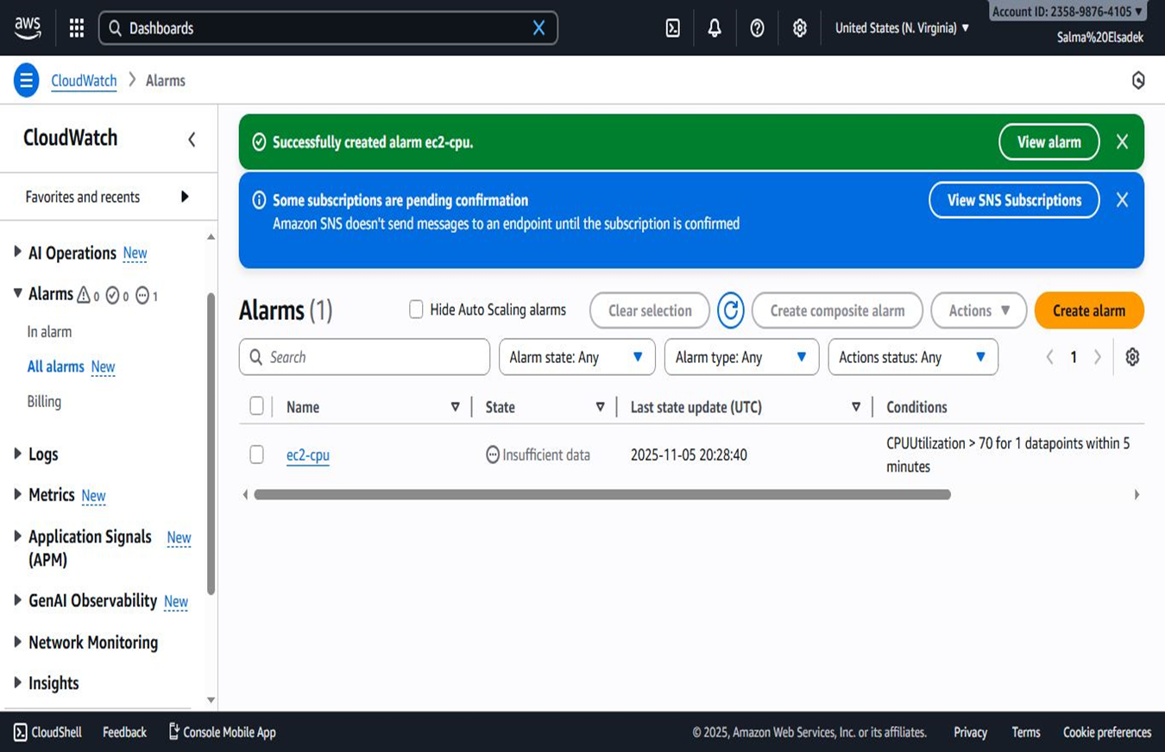
Problem Statement
HR
Finance
Full Stack
Cloud Computing
Insert your topic here
Alarm

Slide 26
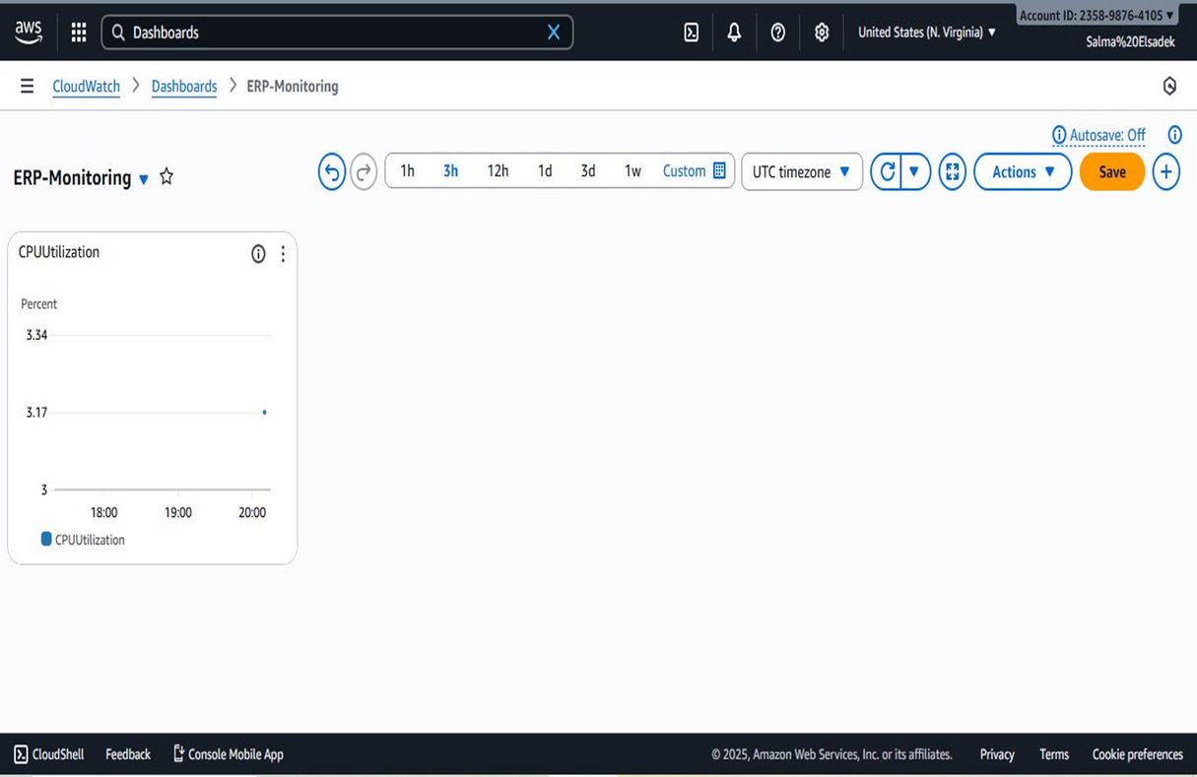
Problem Statement
HR
Finance
Full Stack
Cloud Computing
Insert your topic here
Cloud watch

Slide 27
Problem Statement
HR
Finance
Full Stack
Cloud Computing
Insert your topic here
Security & Disaster Recovery (DR)
IAM Role: Instance Profile for secure access to S3 and CloudWatch.
DR Strategy: Pilot Light (Warm Standby) in a secondary region.
Data Protection: Daily automated snapshots with 7-day retention (DLM).
Bucket Security: SSE-S3 encryption and Bucket Keys enabled.
Visuals: Architecture diagram + S3 Bucket Properties screenshot.

Slide 28
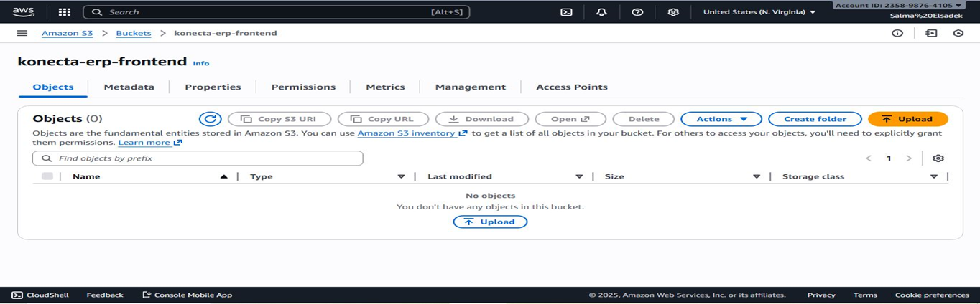
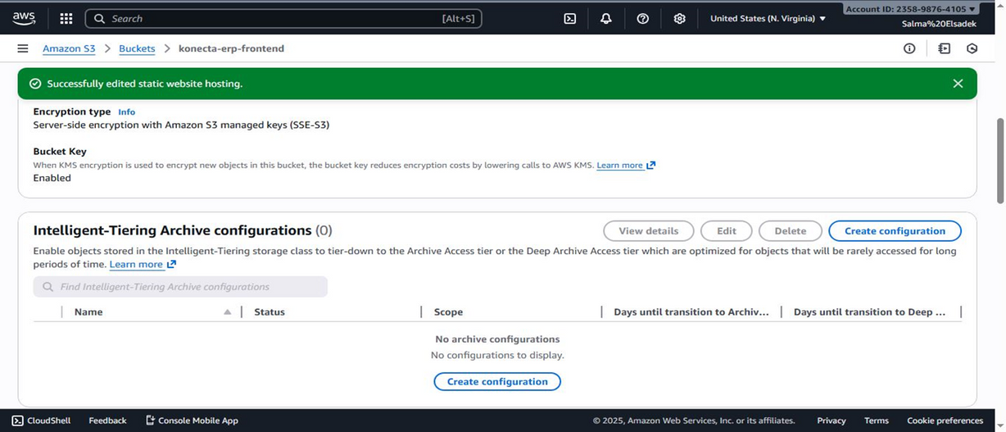
Problem Statement
HR
Finance
Full Stack
Cloud Computing
Insert your topic here
S3 Bucket

Slide 29
Problem Statement
HR
Finance
Full Stack
Cloud Computing
Insert your topic here
Infrastructure as Code (IaC) & Deployment
Terraform: Entire infrastructure defined as code.
Microservices Ready: S3 static frontend + ECS Fargate backend design.
Remote Management: Secure SSH access using MobaXterm.
Static Hosting: S3 static website hosting enabled.
Visuals: MobaXterm terminal session + S3 hosting success banner.

Slide 30
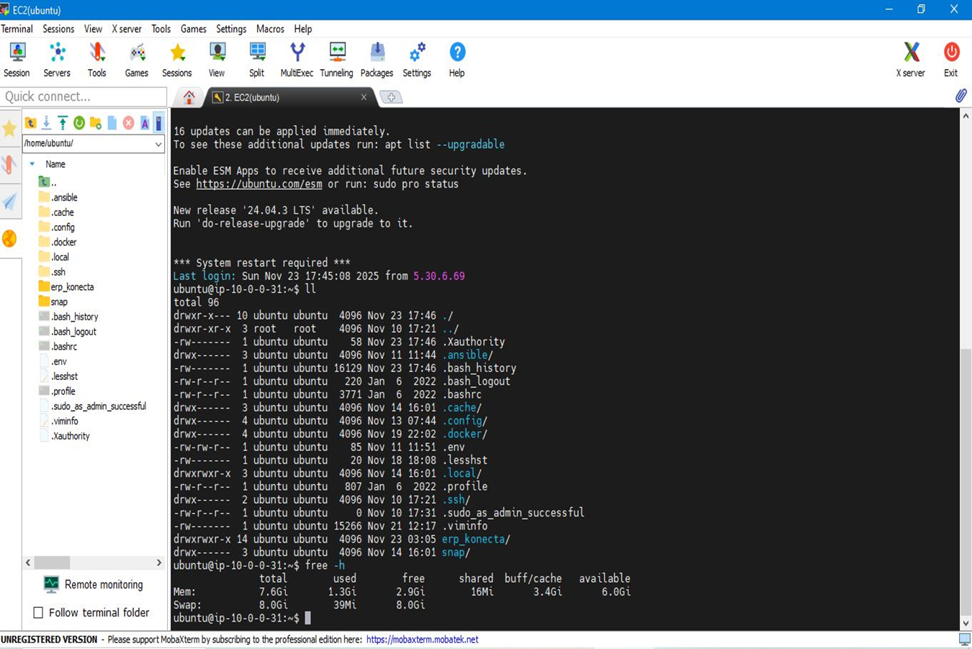
Problem Statement
HR
Finance
Full Stack
Cloud Computing
Insert your topic here
SSH access

Slide 31
Problem Statement
HR
Finance
Full Stack
Cloud Computing
Insert your topic here
Constraints & Financial Strategy
Free Tier Navigation: t3.large and 50GB gp3 are outside Free Tier.
Managed Services Deferral: RDS and ECS Fargate deferred to reduce costs.
Replication Costs: Cross-region DR features incur extra charges.
Future Roadmap: Scalable foundation for full managed microservices.

Slide 32
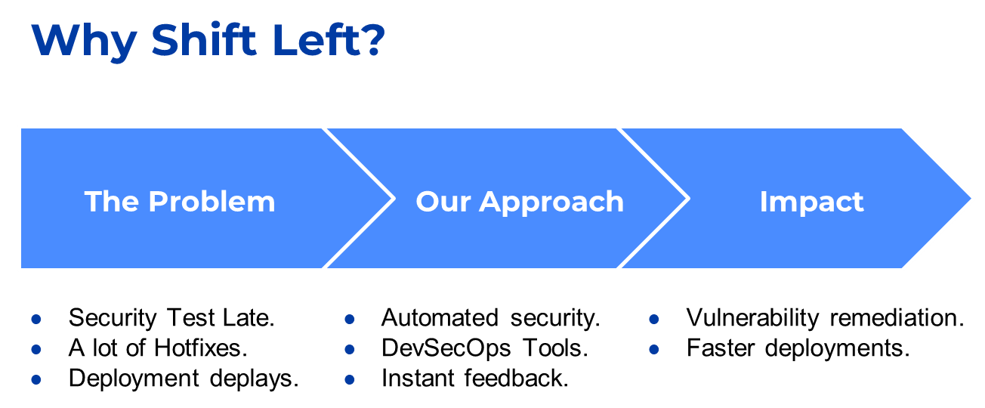
Problem Statement
HR
Finance
Full Stack
Cloud Computing
DevOps
Shifting Left

Slide 33
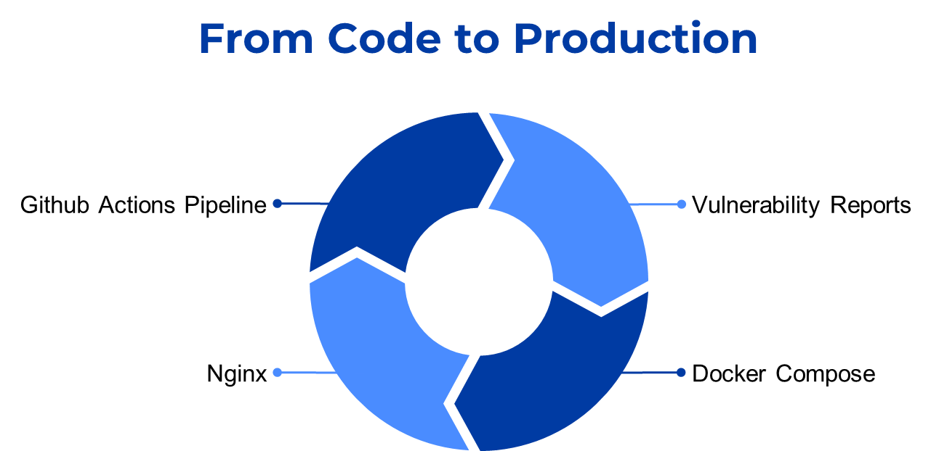
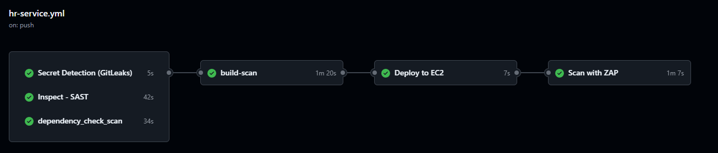
Problem Statement
HR
Finance
Full Stack
Cloud Computing
DevOps
Pipeline

Slide 34
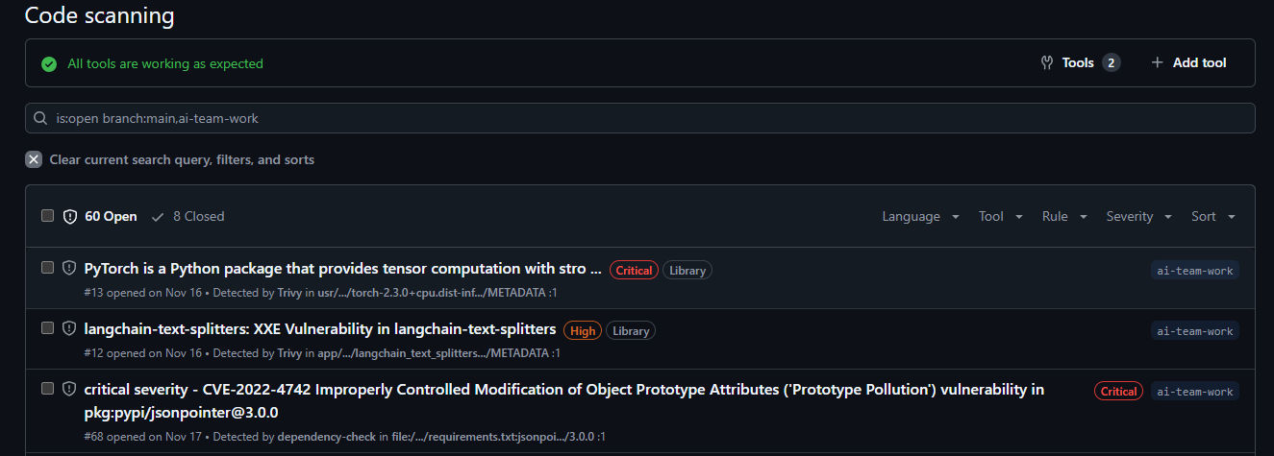
Problem Statement
HR
Finance
Full Stack
Cloud Computing
DevOps
vulnerability Report

Slide 35
Problem Statement
HR
Finance
Full Stack
Cloud Computing
DevOps
vulnerability Report

Slide 36
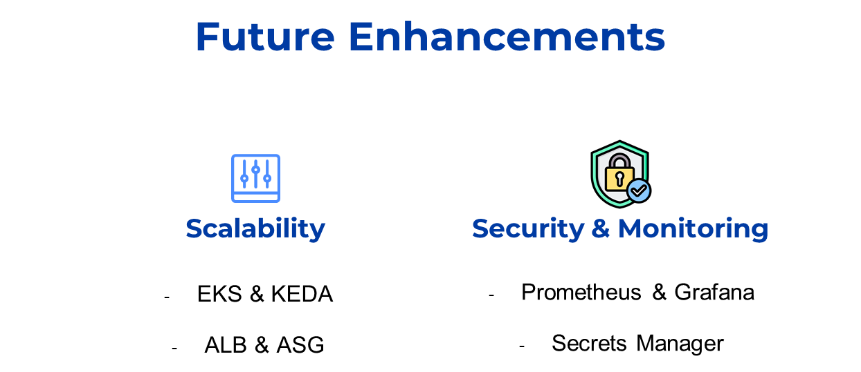
Problem Statement
HR
Finance
Full Stack
Cloud Computing
DevOps
Future Enhancements

Slide 37
Problem Statement
HR
Finance
Full Stack
Cloud Computing
Cybersecurity
1. Project Status: Cloud Architecture & Initial Setup
2. Security Assessment: Infrastructure Gaps
3. Critical Findings: Penetration Test Results (SQLi, Data Exposure)
4. Risk & Impact: Conditional Approval Status
5. Remediation Roadmap: Immediate & Short-Term Fixes
6. Strategic Security: GRC Framework (NEW)
Cybersecurity Assessment

Slide 38
Problem Statement
HR
Finance
Full Stack
Cloud Computing
Cybersecurity
Week 2 Setup Summary
Week 2 Setup Summary:
Architecture: Microservices-ready layout deployed on AWS.
Network (VPC): Configured with 2 Public Subnets (Frontend access) and 2 Private
Subnets (Backend/Database isolation).
Compute:
Backend: EC2 instance (Ubuntu 22.04, t2.micro) with restricted HTTP/SSH access.
Frontend: S3 bucket configured for static website hosting.
Operational Controls:
Monitoring: CloudWatch is active (CPU utilization alarms).
Cost: AWS Budgets configured with a $20 limit and 80% usage alerts.
Week 2 Setup Summary
Week 2 Setup Summary:
Architecture: Microservices-ready layout deployed on AWS.
Network (VPC): Configured with 2 Public Subnets (Frontend access) and 2 Private
Subnets (Backend/Database isolation).
Compute:
Backend: EC2 instance (Ubuntu 22.04, t2.micro) with restricted HTTP/SSH access.
Frontend: S3 bucket configured for static website hosting.
Operational Controls:
Monitoring: CloudWatch is active (CPU utilization alarms).
Cost: AWS Budgets configured with a $20 limit and 80% usage alerts.
Project Status: Cloud Architecture Overview

Slide 39
Problem Statement
HR
Finance
Full Stack
Cloud Computing
Cybersecurity
Positive Controls:
Network isolation using subnets
Restricted EC2 access (HTTP/SSH only)
Active monitoring enabled
Security Gaps:No encryption (data at rest & in transit)
Public S3 bucket access
Weak IAM roles (no least privilege)
No disaster recovery or backup strategy
Security Assessment

Slide 40

Problem Statement
HR
Finance
Full Stack
Cloud Computing
DevOps
AI & ML
HR Use Cases — Predictive & Generative AI
Purpose: Predict employee attrition and training needs from HR data.
Models:
Attrition: XGBoost (90% accuracy)
Training needs: Logistic Regression (83% accuracy)
Explainability: SHAP (global drivers) and LIME (individual explanations).
GenAI: Gemini-generated, plain-English retention and training recommendations.
Deployment: FastAPI microservice on Hugging Face Spaces, integrated with ERP. (Live Demo)

Slide 41

Problem Statement
HR
Finance
Full Stack
Cloud Computing
DevOps
AI & ML
HR Use Cases — CV Parsing & Candidate Ranking
Purpose: Automated CV screening by measuring semantic match between JDs and CVs.
Models:
Gemini-2.5-Flash (CV field extraction)
Gemini Embeddings + cosine similarity (ranking)
Pipeline
Structured Parsing
(using Gemini LLM)
Creates Embedding for JD &CV
Computes cosine similarity & Ranking
Text Extraction
(live demo)

Slide 42

Problem Statement
HR
Finance
Full Stack
Cloud Computing
DevOps
AI & ML
Finance Use Cases — Classical Models
Purpose: Forecast Revenue, Expenses, and Cash Flow for ERP planning.
Data: Quarterly financial data (40 quarters, 2015–2024).
Models Compared: ARIMA, SARIMAX, Prophet.
Validation:
Lagged regressors to prevent data leakage.
Backtesting on last 4 quarters (Q1–Q4 2024).
Evaluation using MAE and RMSE.
Final Model: Prophet — best balance of accuracy, robustness, and interpretability.
Deployment: Dockerized FastAPI service on Hugging Face Spaces (Live API).

Slide 43

Problem Statement
HR
Finance
Full Stack
Cloud Computing
DevOps
AI & ML
Finance Use Cases — Deep Learning Models
Data: 2000 rows, 30 columns
Models Tested: RNN, LSTM, Temporal Fusion Transformer (TFT).
Final Model: TFT — handles multivariate financial and market signals.
Setup: 8 past quarters → 1-quarter ahead prediction.
Output: Forecasts + error metrics in ERP-ready JSON.
Deployment: FastAPI + Docker on Hugging Face Spaces (Live Demo).

Slide 44



Problem Statement
HR
Finance
Full Stack
Cloud Computing
DevOps
AI & ML
Automated Document Processing Use Case
Input: PDFs and scanned images (invoices, POs, approvals).
Extraction: OCR + PDF parsing to convert unstructured documents into text.
Classification: LLM-based document type detection.
Structuring: Key-value extraction into structured JSON.
Storage: MongoDB with semantic embeddings for deduplication and search.
Deployment: Deployed on Hugging Face Spaces (Live Demo).

Slide 45

Problem Statement
HR
Finance
Full Stack
Cloud Computing
DevOps
AI & ML
ERP Chatbot (RAG + Generative AI) Use Case
Use Case: Natural-language Q&A over ERP invoices.
UI: Interactive chatbot interface for querying ERP documents.
Retrieval: Semantic search using sentence embeddings + MongoDB vector index.
Generation: Context-aware answers generated by an LLM using retrieved invoice data.
Result: Accurate, grounded responses with reduced hallucination risk.
Deployment: Deployed as a web application on Hugging Face Spaces (Live Demo).

Slide 46



Problem Statement
HR
Finance
Full Stack
Cloud Computing
DevOps
AI & ML
Digital Marketing
Overview – The Nexus Transformation Phases
Preparation & Content Development
Strategy & Brand Identity
Campaign Rollout & Execution

Slide 47



Problem Statement
HR
Finance
Full Stack
Cloud Computing
DevOps
AI & ML
Digital Marketing
Strategy & Brand Identity
Objective: Establishing the foundation for the ERP transition through research and creative design.
Conducted interviews to align the ERP branding with organizational needs and business goals.
Designed the "Nexus" identity, including the logo, visual guidelines, and the "Get It Done" tagline. Branding
Drafted the initial awareness campaign and internal adoption communication plans to ensure 100% employee reach

Slide 48



Problem Statement
HR
Finance
Full Stack
Cloud Computing
DevOps
AI & ML
Digital Marketing
Preparation & Content Development
Objective: Building the educational assets required to move employees from awareness to competency.
Drafted technical training scripts and structured outlines for role-based onboarding videos.
Collaborated with HR to integrate change management planning, ensuring a smooth cultural shift.
Prepared high-quality training video scripts and comprehensive user guides for various departments.

Slide 49


Problem Statement
HR
Finance
Full Stack
Cloud Computing
DevOps
AI & ML
Digital Marketing
Campaign Rollout & Execution
Objective: Driving engagement and system adoption through multi-channel communication.
Created the teaser campaign and awareness emails to build anticipation and reduce resistance.
Rolled out the official ERP launch campaign, including final countdowns and executive announcements.
Established the "Improvement Suggestion Box" to capture real-time user insights.

Slide 50




Problem Statement
HR
Finance
Full Stack
Cloud Computing
DevOps
AI & ML
Digital Marketing
Expected Outcomes
A complete 10-week awareness strategy is finalized and ready for immediate implementation.
The internal narrative has successfully transitioned from resisting change to accepting the ERP as a beneficial tool.
All role-specific user training scripts and onboarding videos are produced and ready for deployment.
A full library of professional awareness emails and teaser content is prepared for the rollout.

Slide 51




Problem Statement
Cloud Computing
Digital Marketing
HR
Finance
Full Stack
DevOps
AI & ML
Final Integration
Insert your topic here
Business Value
Business Value
Higher efficiency
Better data accuracy
Faster decision-making
Scalability & Security

Slide 52
Thank You
Thank You :)
Any questions?

